Slide 1

INTRODUCTORY IMPULSES: PRESCHOOL TEACHER TRAINING AND MEDICAL COLLEGE IN VRŠAC, REPUBLIC OF SERBIA
International Week 2026 (Zagreb, Croatia)
Interdisciplinarity by Design: Building the Future University
16 – 20 March 2026
Danica Veselinov, PhD, director and Ivana Đorđev, PhD – team member of the
Institutional Department for International Relations,
Preschool Teacher Training and Medical College in Vršac

Slide 2
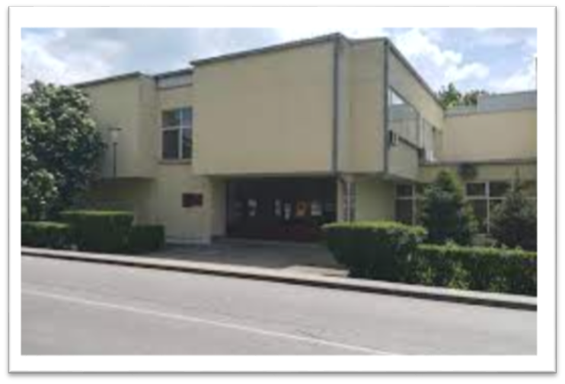


Preschool Teacher Training and Medical College in Vršac, Republic of Serbia
Institution type:
State higher education institution
Website: www.uskolavrsac.edu.rs
Erasmus code: RS VRSAC01
Contact: Institutional Department for International Relations:
Coordinator Radmila Palinkašević, PhD – palinkasevic@gmail.com
ROR ID: https://ror.org/04hwwj593

Slide 3


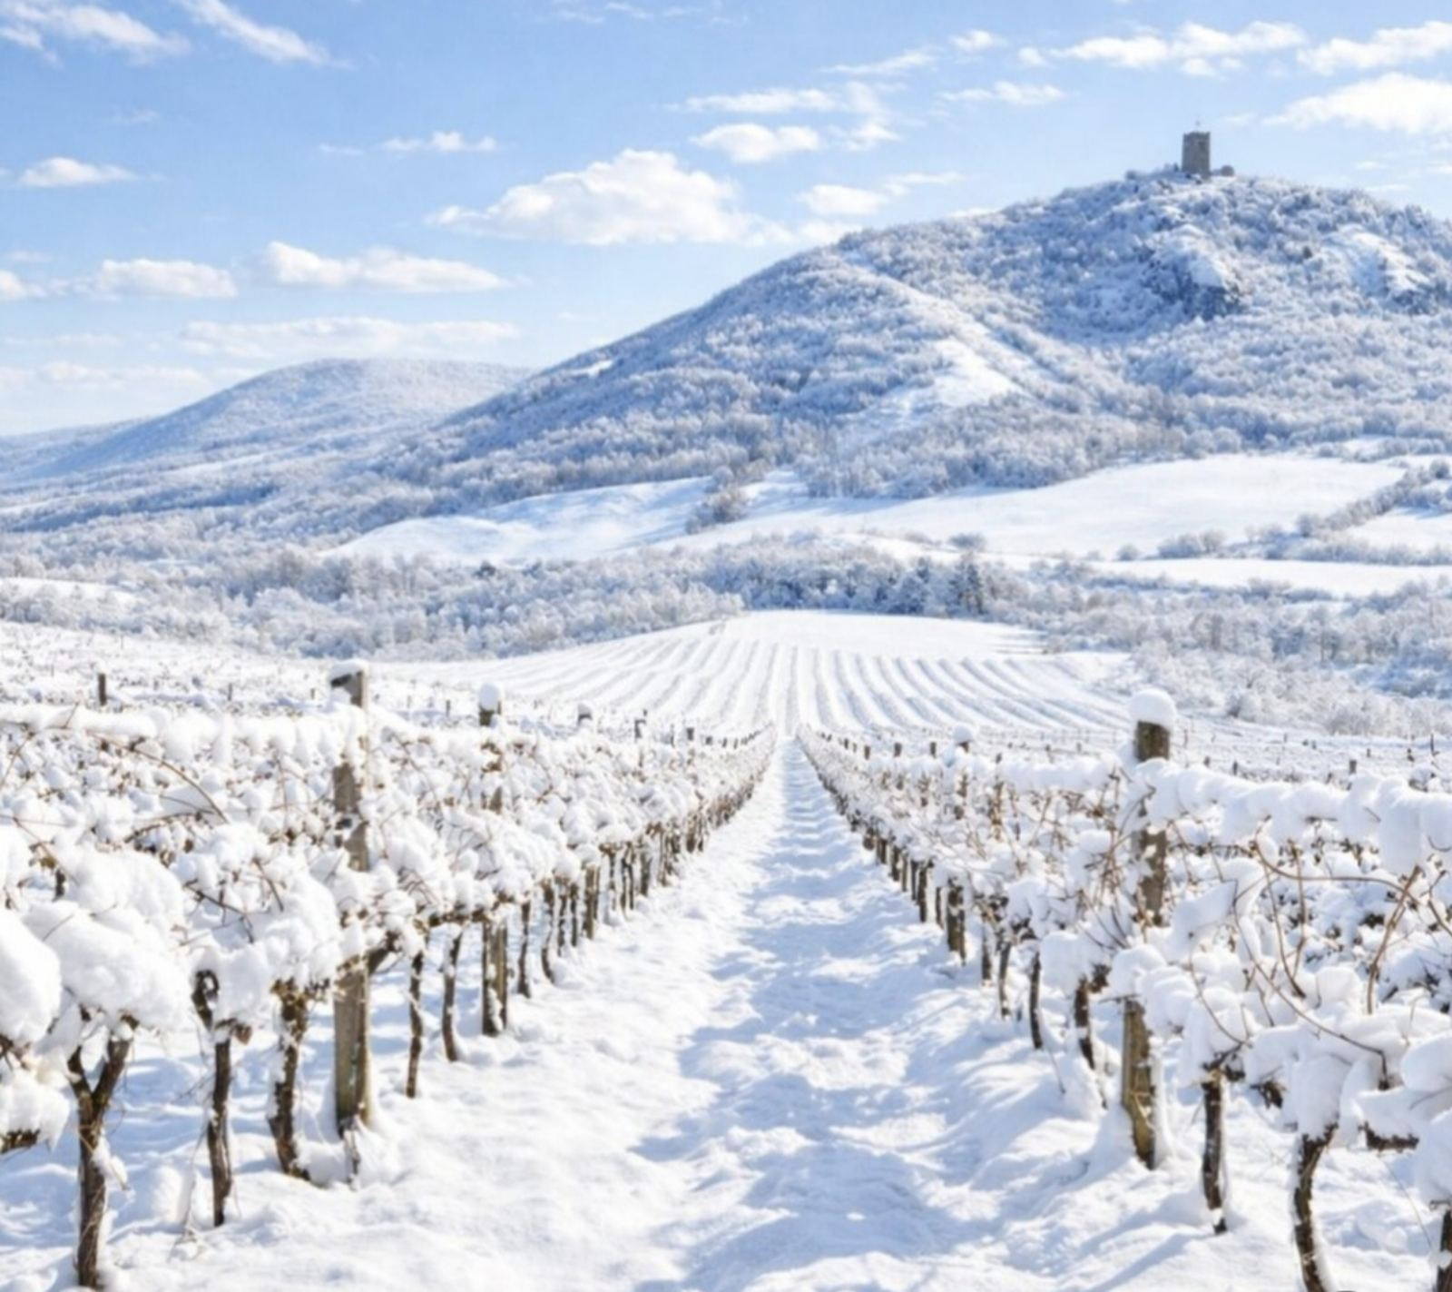


About us
In Vršac, a teacher training school was founded in 1920. It became a Pedagogy Academy in 1973, a College in 1993, and a Higher Education Institution in 2007.
The institution provides Bachelor studies in Preschool Teaching and Medical Nursing, and Master studies in Preschool Teaching.
Today, instruction is delivered in three languages – Serbian, Romanian and Roma.
The College is a European Talent Point, and a winner of the Great Gold Medal for High Quality Education.
It publishes the open-access journal Research in Pedagogy: http://research.rs;
More than 30 years of tradition in organizing the international round table on giftedness: https://uskolavrsac.edu.rs/nauka/#home.
QR code to the website of the Preschool Teacher Training and Medical College in Vršac

Slide 4
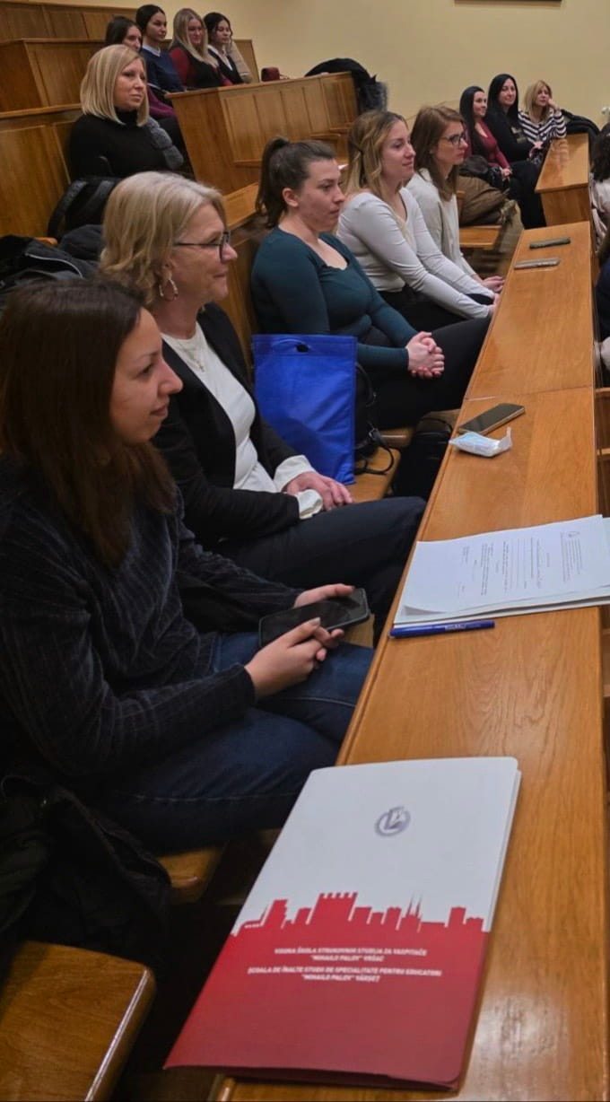
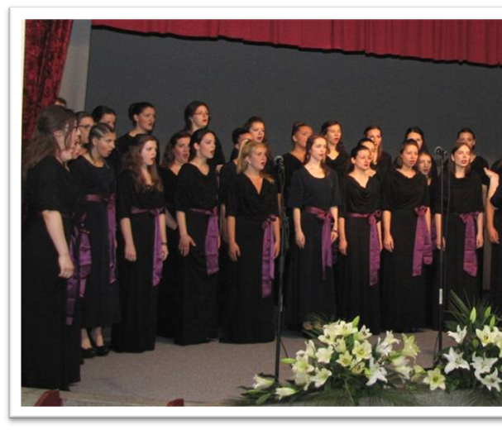
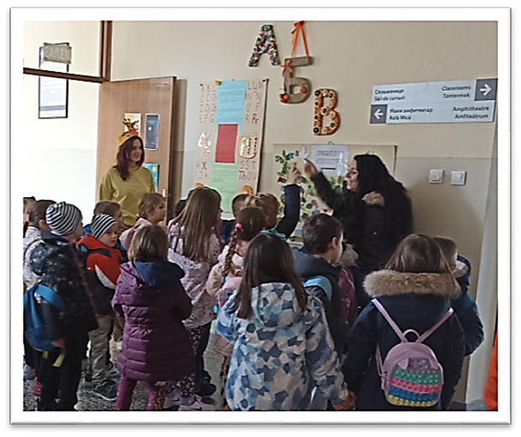
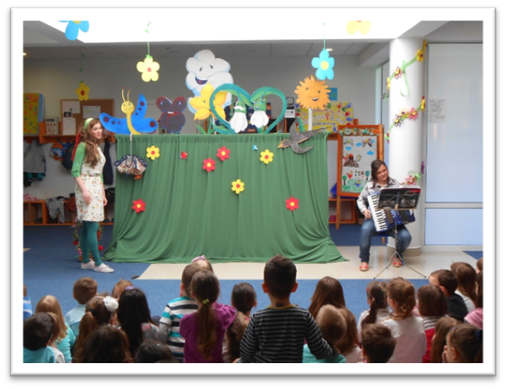
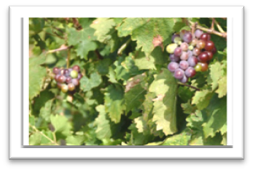
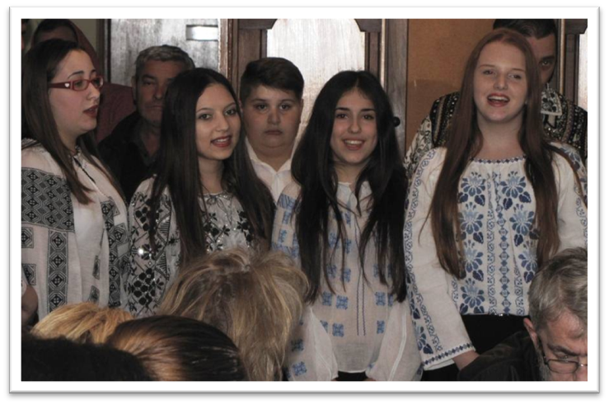
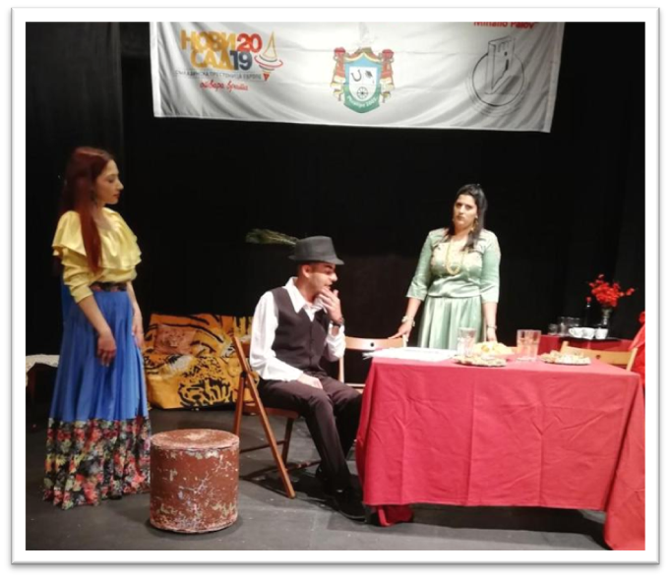
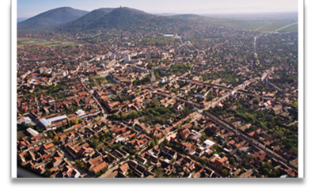
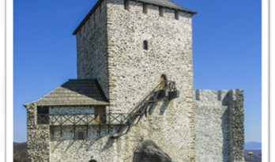
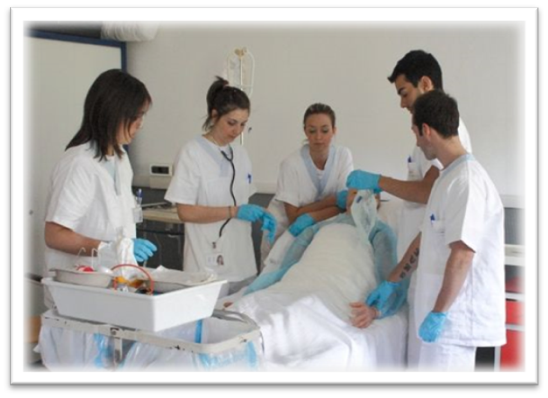
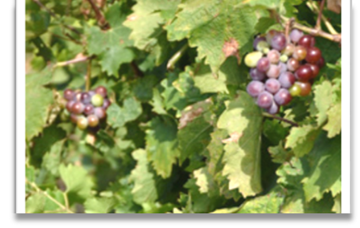
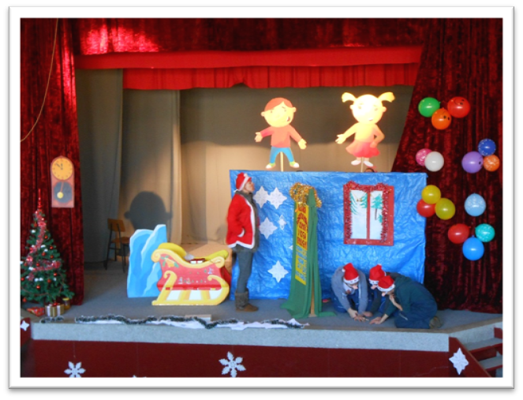
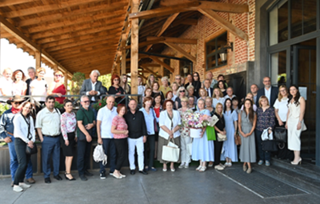
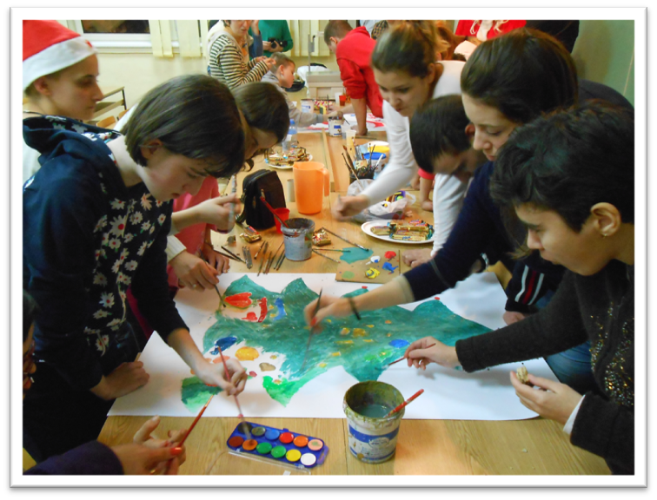
4
Activities at our College
4

Slide 5
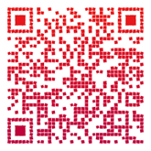
Study programmes
About Us – Publication
Study Programme Name (English) | Original Name (Serbian) | Cycle | EQF Level | ISCED Broad Field | ISCED Detailed Code | ISCED Detailed Field Name | Duration | ECTS Credits
Preschool Teacher | Strukovni vaspitač | Undergraduate studies | EQF 6 | 011 Education | 0112 | Training for pre-school teachers | 3 years | 180 ECTS
Nurse / Medical Technician | Strukovna medicinska sestra / tehničar | Undergraduate studies | EQF 6 | 091 Health | 0913 | Nursing and midwifery | 3 years | 180 ECTS
Master Preschool Teacher | Strukovni master vaspitač | Graduate studies | EQF 7 | 011 Education | 0112 | Training for pre-school teachers | 1–2 years | 60–120 ECTS

Slide 6

International Cooperation
The Preschool Teacher Training and Medical College in Vršac establishes bilateral cooperation with numerous institutions through a wide range of activities, including:
the organization of joint scientific and professional conferences in Serbia and abroad;
the joint implementation of international scientific and professional projects;
collaborative publishing activities;
lectures delivered by visiting professors, as well as the organization of forums, book promotions, and related academic events;
the mobility of (non-)teaching staff and students...
6

Slide 7
Examples of interdisciplinarity at the Preschool Teacher Training and Medical College in Vršac
Integrated curriculum approach: Integrative Approach to Educational Content in a Foreign Language; Integrative Approach in Work with Preschool Children
Research and development: Methodical System as a Carrier of a Reflective Approach in an Integrated Curriculum
Heuristic Center & Lifelong Learning Center: support for interdisciplinary teaching, professional development and innovation
Micro-credentials and short programs: the gifted
International interdisciplinary projects
TEMPUS – TEACH (2013–2016) – Harmonization of Preschool Teacher Curricula in Serbia
Erasmus+ KEY – Keep Educating Yourself (2019–2022) – development of teacher CPD resources and publications
Erasmus+ STATUS (2021–2025) – support for underrepresented students in higher education
Romania–Serbia (FUNED: For Unique New Education Design, 2021 – 202) – innovative methodological approaches and professional development of preschool teachers
Round Tables on Giftedness
Research in Pedagogy (Open Access Journal)
...
7

Slide 8
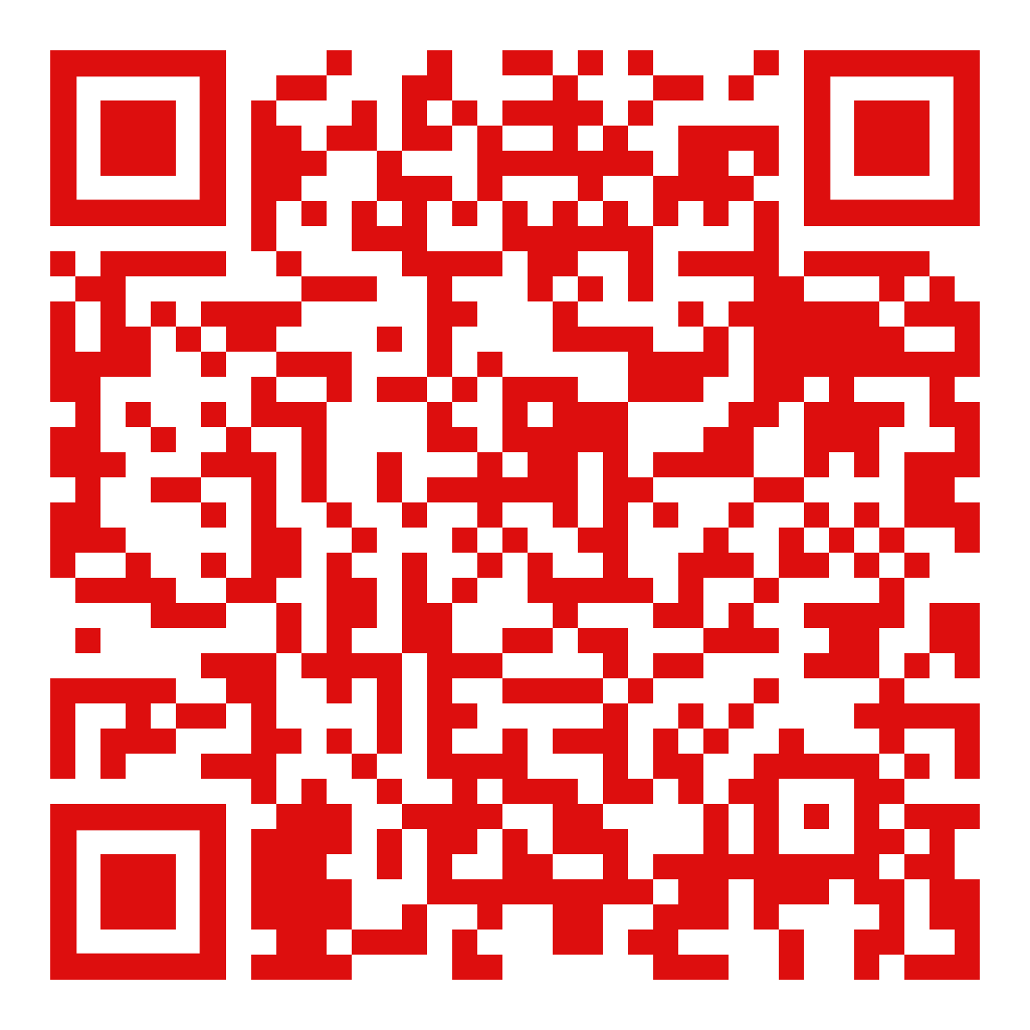
Annual student conference; proceedings published every year
Erasmus+ participants are welcome to join our annual student conference ,,Contemporary Challenges in Didactics and Education.”
We invite students and their mentors to participate.
Conference partner institutions include: Preschool Teacher Training and Medical College in Vršac; “Aurel Vlaicu” University of Arad (Romania); West University of Timișoara (Romania); and “St. Kliment Ohridski” University – Bitola (North Macedonia).
Proceedings (7th edition) are available online (scan the QR code).
The call for participation is published on the College website (https://www.uskolavrsac.edu.rs/).
8

Slide 9
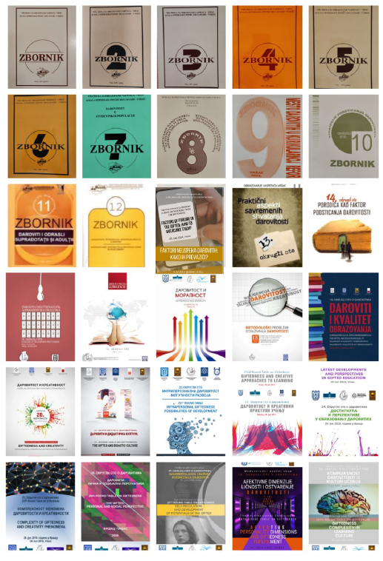

The Preschool Teacher Training and Medical College in Vršac as a European Talent Point
Over 30 years of Round Tables on Giftedness held in Vršac
Total participants: more than 2,000
Published papers: more than 1,000
International reach: representatives of over 200 institutions
Geographical coverage: institutions from more than 20 countries
Annex: 30 Years on Giftedness in Vrsac (Book)
9

Slide 10
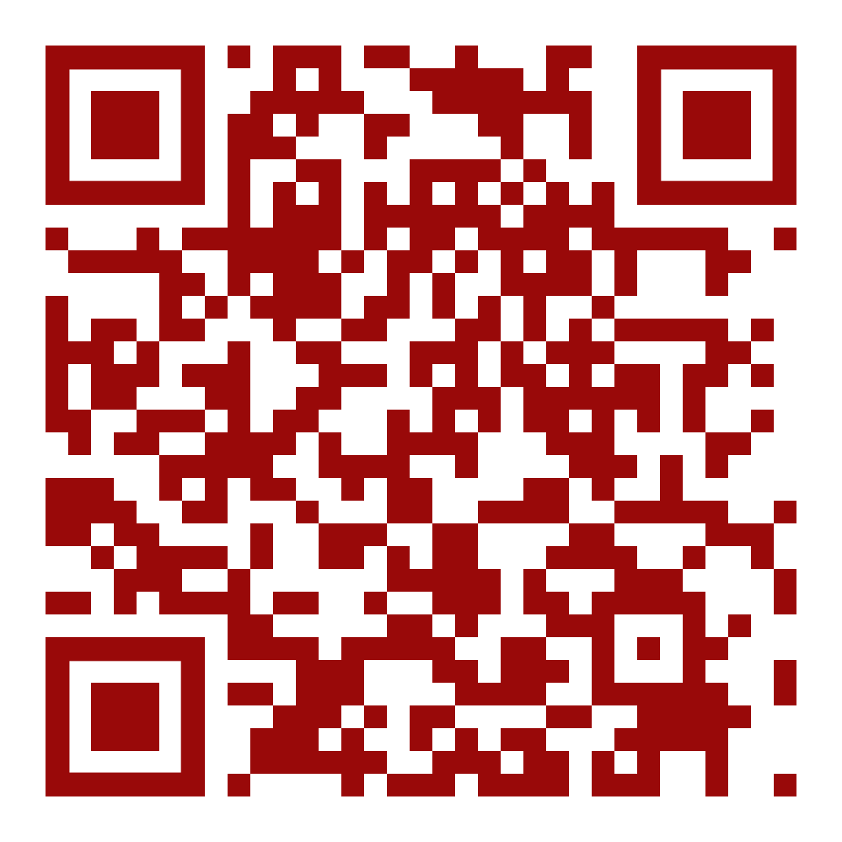
Examples of Interdisciplinarity
1. Video – Language Club Students https://www.youtube.com/watch?v=UiBEQtHl2J4&feature=youtu.be Short video with quotations about language and the importance of
nurturing the mother tongue. (Pedagogy + Linguistics + Literature + Media Communication)
2. Audio Recording – Acoustic Dramatization of Children’s Text https://youtu.be/oa0YrGTnGYc
Students created an audio dramatization of a text for children as part of educational activities. (Literature + Pedagogy + Performing Arts + Audio/Media Production)
3. Exhibition in the School Hall – International Mother Language Day https://www.uskolavrsac.edu.rs/medjunarodni-dan-maternjeg-jezika-3/ Exhibition organized in the school hall presenting language-related educational and cultural materials. (Education + Linguistics + Cultural Studies + Visual Presentation)
4. Virtual Exhibition “Iskaži pa prikaži” (2023) https://www.artsteps.com/view/6484ed95448345da6d3bc330 Virtual exhibition of children’s language creativity and visual artworks by preschool teachers. (Pedagogy + Children’s Language Development + Visual Arts + Digital Technologies)
10

Slide 11

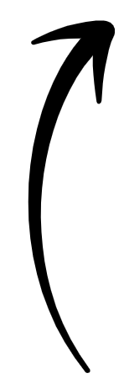
Erasmus+ Activities at our Institution – Key Highlights
Mobility Types
Long-term study mobility –
one semester at a partner institution abroad.
Long-term traineeship mobility – professional practice lasting one to three months.
Blended Intensive Programme (BIP) – short-term mobility with online learning component.
(Current) partner institutions from:
Zagreb, Alba Iulia, Arad, Blagoevgrad, Istanbul, Iași, Maribor
Examples of BIP Mobilities
Vršac (2023): Multicultural training, international lectures, cultural programme, study visit to Belgrade;
Istanbul (2024): Academic programme and professional visits to kindergartens and primary schools;
Zagreb (2025): Creativity in communication, presentation skills, workshops, teamwork projects.
Explore International Opportunities at Our School – Let’s Connect and Collaborate.
11

Slide 12
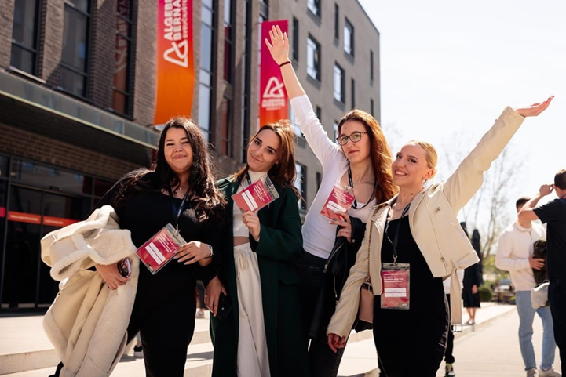
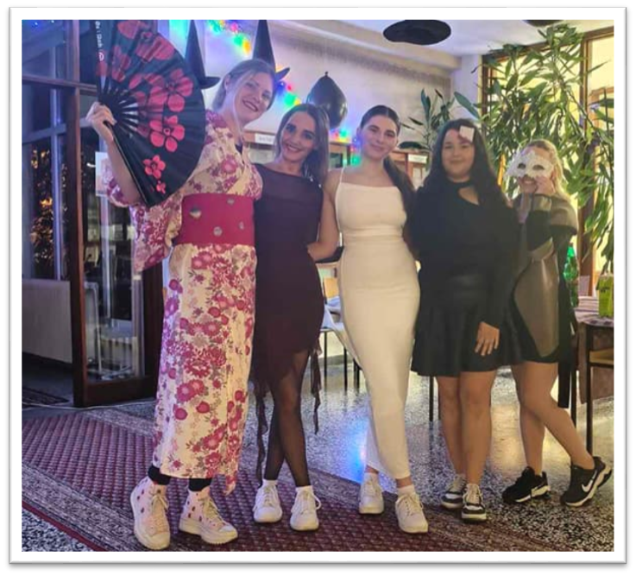
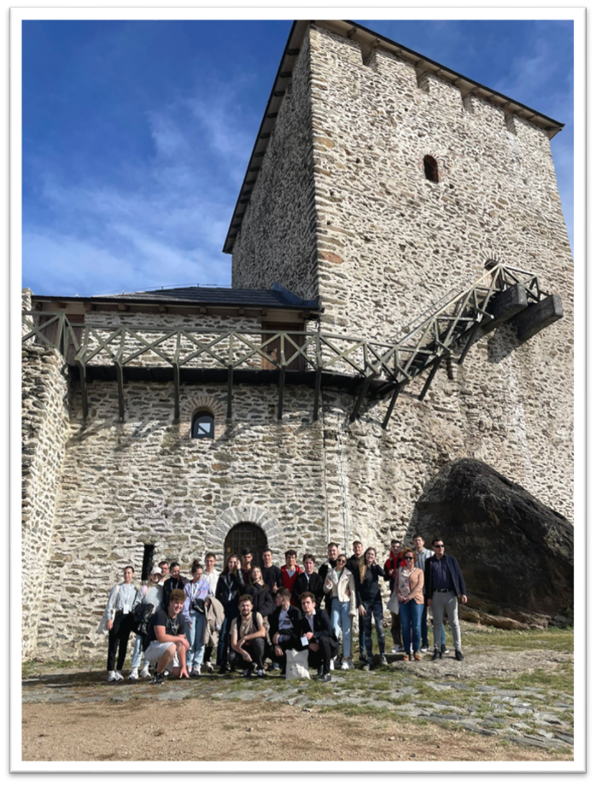
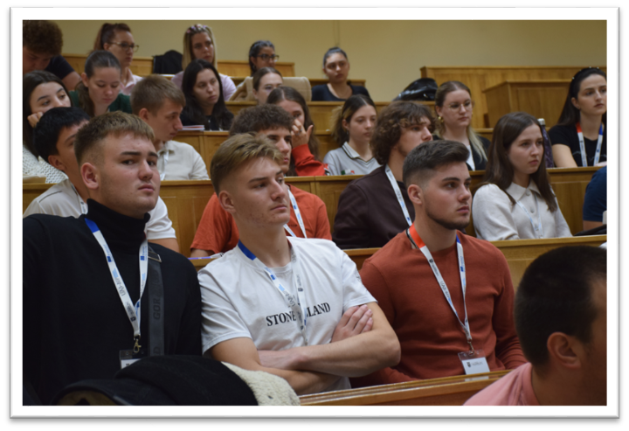
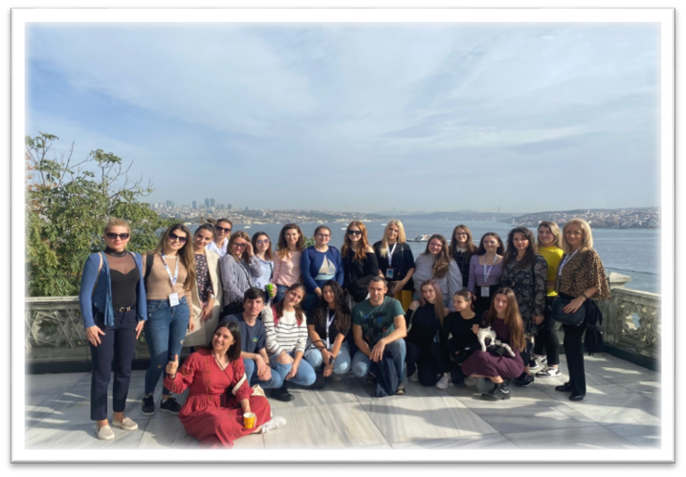
Erasmus
memories
12

Slide 13
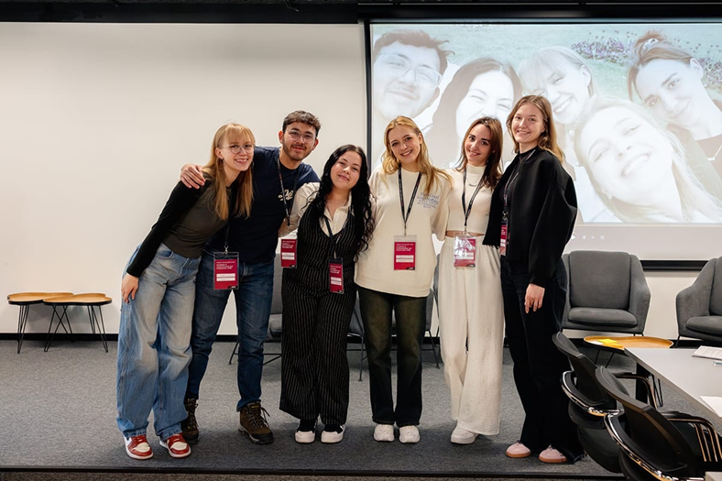
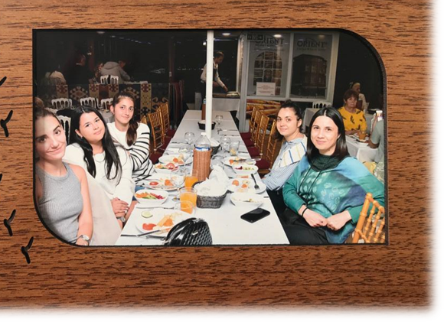

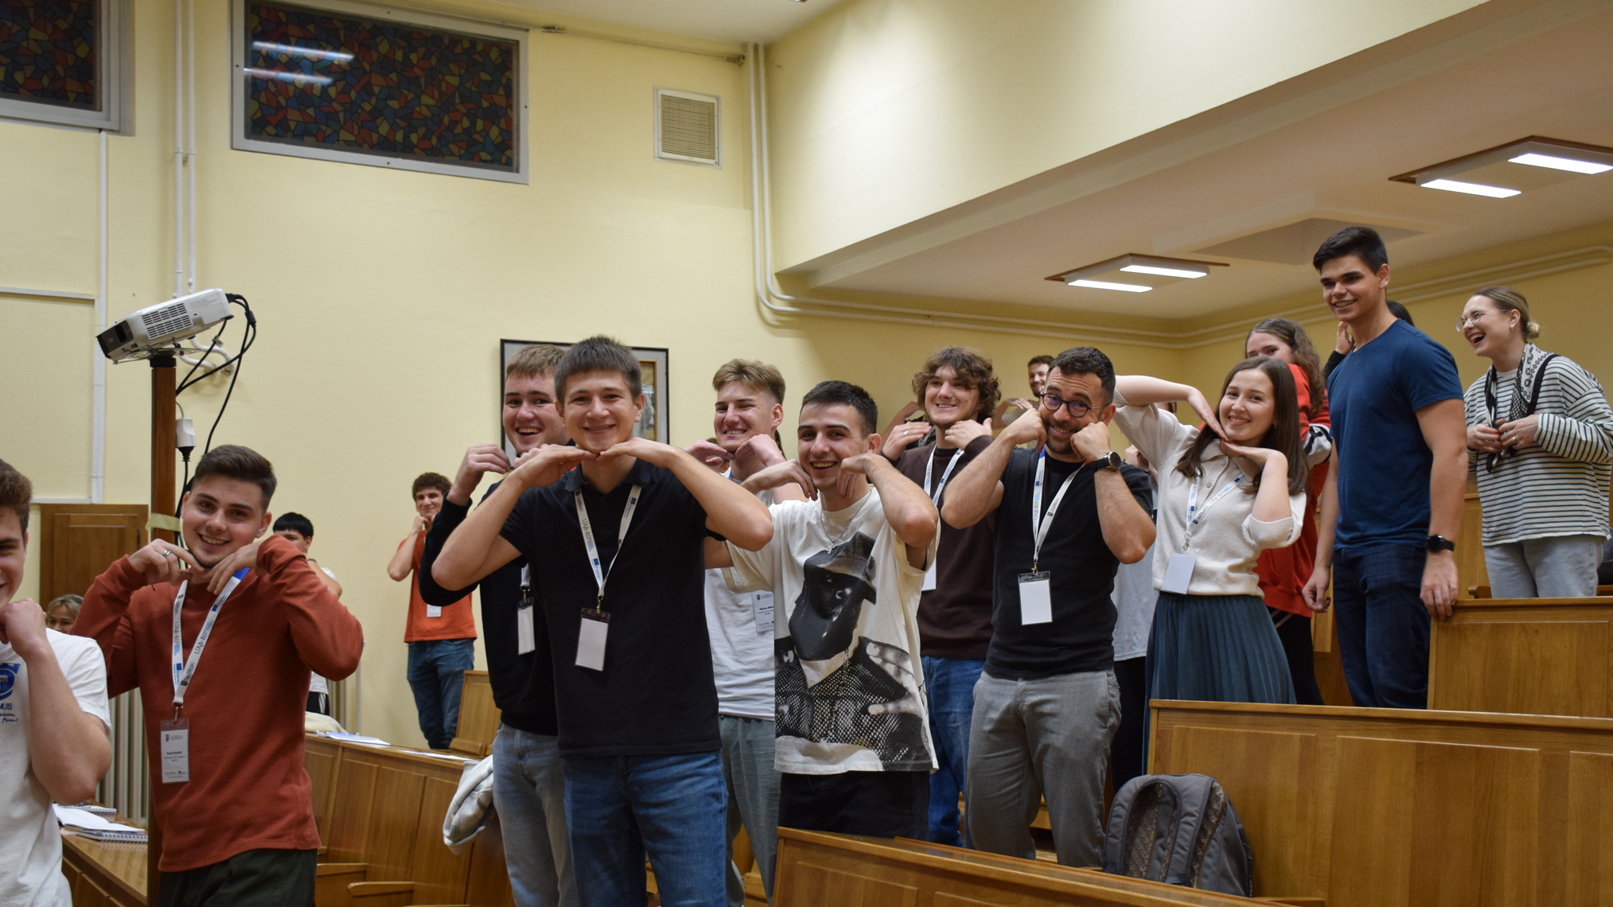
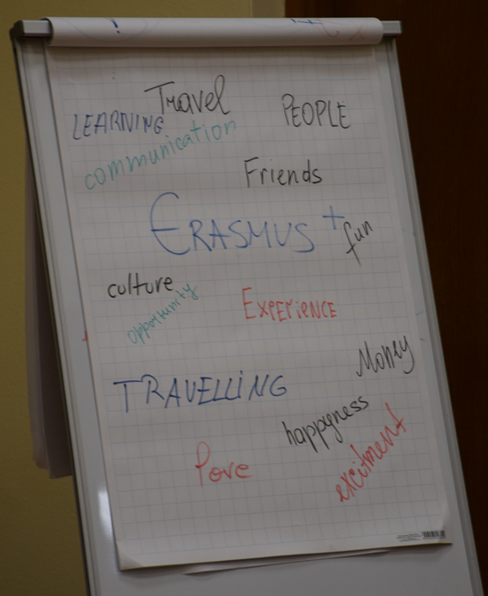
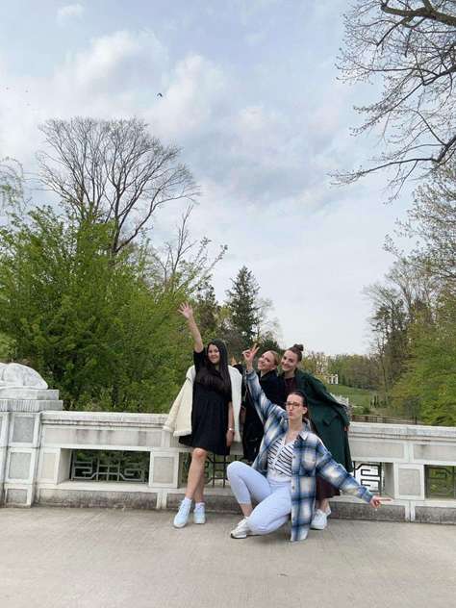
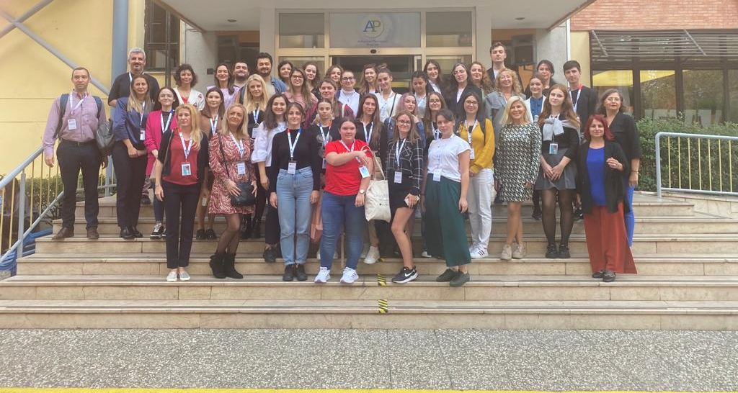
Some responses from students participating in Erasmus Mobility
13

Slide 14

ERASMUS+ MOBILITY IS A BRIDGE.
Some responses from students participating in
Erasmus mobility
It connects cultures, institutions, and individuals, helping participants overcome geographical and academic distances. Through this experience, students build new knowledge, cooperation, and lasting international academic connections.

Slide 15

Some responses from students participating in
Erasmus mobility
ERASMUS MOBILITY AS A CAROUSEL
Like the rotations of a carousel, Erasmus mobility continuously broadens students’ worlds through new experiences, cultures, and knowledge. This metaphor highlights mobility as a dynamic and enriching journey that brings excitement, discovery, and personal growth while learning to navigate new academic and cultural environments.

Slide 16

Some responses from students participating in
Erasmus mobility
THE ROLLER COASTER METAPHOR
The roller coaster metaphor highlights the dynamic and sometimes slightly unpredictable nature of mobility experiences. Participants encounter rapid changes, new academic and cultural environments, and moments of excitement that require adaptability, openness, and creativity. Like a roller coaster with safety mechanisms, Erasmus mobility is supported by institutional partnerships and structured programmes that help participants navigate these changes while fostering personal and professional growth.

Slide 17
Erasmus mobility in metaphors: student activity
Erasmus mobility is / I experience it as...
(Please complete the sentence.)
Participation is anonymous and voluntary. Thank you!

Slide 18
Erasmus mobility in metaphors: student activity
Train – many stops along the journey;
Airplane – suddenly changes perspective;
Bicycle – teaches balance and independence;
Ship – adventure and uncertainty;
Walk – your own pace;
Car – creating your own path;
Other (please specify).
Choose a travel metaphor that best reflects how you experience or imagine the course of your Erasmus mobility.

Slide 19
Erasmus mobility in metaphors: student activity
Rainbow – connection and diversity of experiences that shape your life
Puzzle – bringing different life experiences together into a whole
Stage – a space and setting through which you explore different roles and perspectives in your life
Phoenix – personal transformation and renewal through new experiences
Telescope – gaining a broader perspective and deeper insight into your own life
Other (please specify).
If you have already participated in a mobility, choose the metaphor that best reflects the broader impact and meaning of your experience.
If you have not yet participated, choose the metaphor that best reflects how you think mobility will influence your life or education.

Slide 20
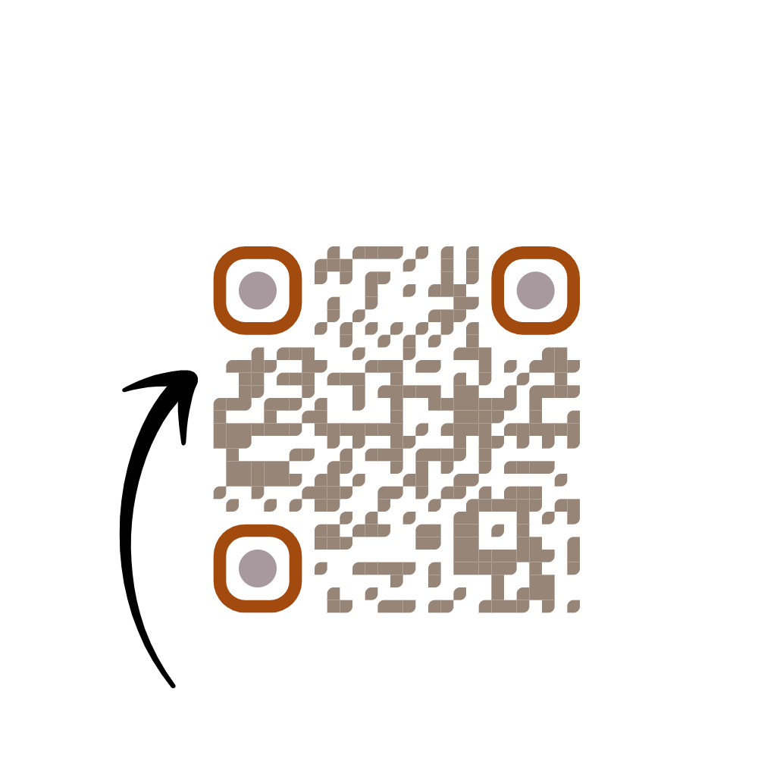
Contact information:
Danica Veselinov, PhD, director and Ivana Đorđev, PhD – team member of the
Institutional Department for International Relations,
Preschool Teacher Training and Medical College in Vršac
vsvasdirektor@hemo.net
ivanacurcin@yahoo.com
Institutional Department
for International Relations
26300 Vrsac
Omladinski trg 1
Tel.+381 13 831 628
Coordinator: Radmila Palinkasevic, PhD
Contact : +381 60 6188154
palinkasevic@gmail.com
Let’s Connect and Collaborate.
Thank you!

