Slide 1


Slide 2
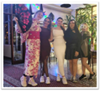



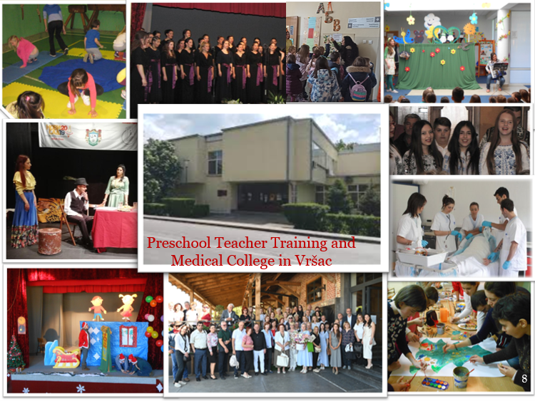


Preschool Teacher Training and Medical College in Vršac, Republic of Serbia
Institution type:
State higher education institution
Website: www.uskolavrsac.edu.rs
Erasmus code: RS VRSAC01
Contact – Institutional Department for International Relations: palinkasevic@gmail.com
ROR ID: https://ror.org/04hwwj593
Instruction is delivered in Serbian, Romanian, and Roma. The College holds the Erasmus Charter for Higher Education, is a European Talent Point, publishes the journal Research in Pedagogy, and has received the Great Gold Medal for High Quality Education.

Slide 3

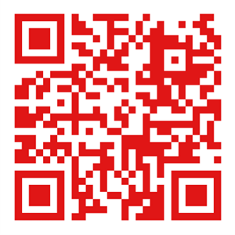
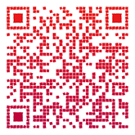
Study Programmes
Explore International Opportunities at Our School
About Us – Publication
Study Programme Name (English) | Original Name (Serbian) | Cycle | EQF Level | ISCED Broad Field | ISCED Detailed Code | ISCED Detailed Field Name | Duration | ECTS Credits
Preschool Teacher | Strukovni vaspitač | Undergraduate studies | EQF 6 | 011 Education | 0112 | Training for pre-school teachers | 3 years | 180 ECTS
Nurse / Medical Technician | Strukovna medicinska sestra / tehničar | Undergraduate studies | EQF 6 | 091 Health | 0913 | Nursing and midwifery | 3 years | 180 ECTS
Master Preschool Teacher | Strukovni master vaspitač | Graduate studies | EQF 7 | 011 Education | 0112 | Training for pre-school teachers | 1–2 years | 60–120 ECTS

