Slide 1

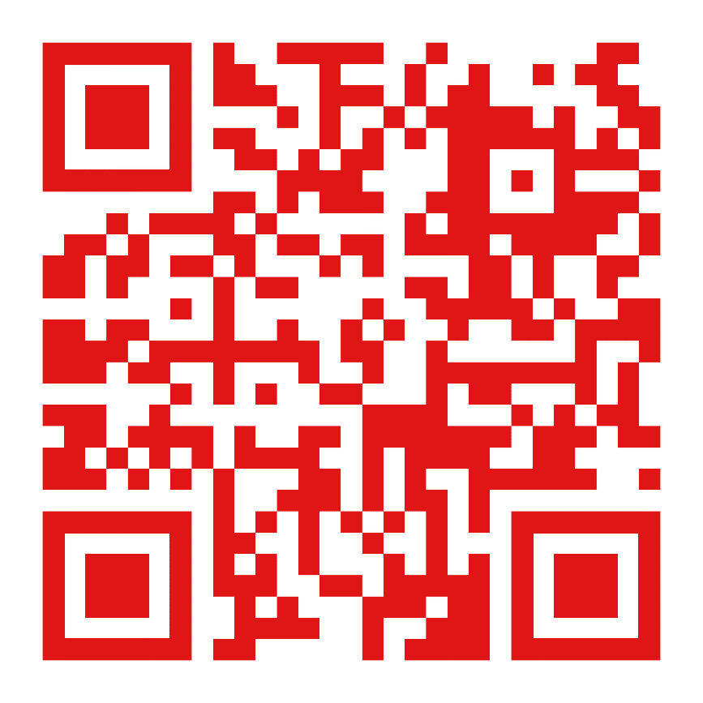


March, 2026
Official website of the Preschool Teacher Training and Medical College in Vrsac, Republic of Serbia
International Week 2026
Interdisciplinarity by Design: Building the Future University
Preschool Teacher Training and Medcial College in Vrsac, Republic of Serbia

Slide 2
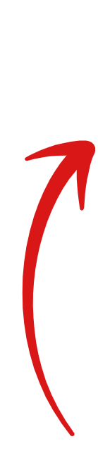
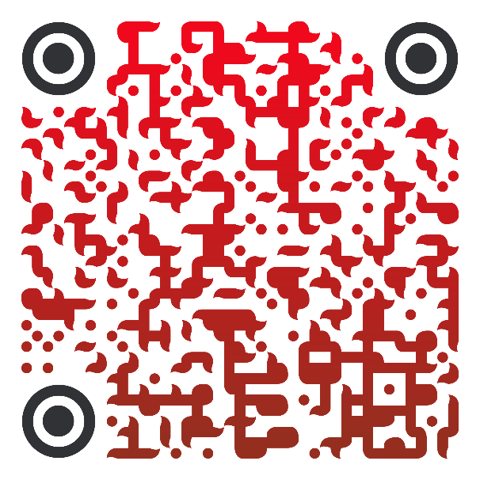
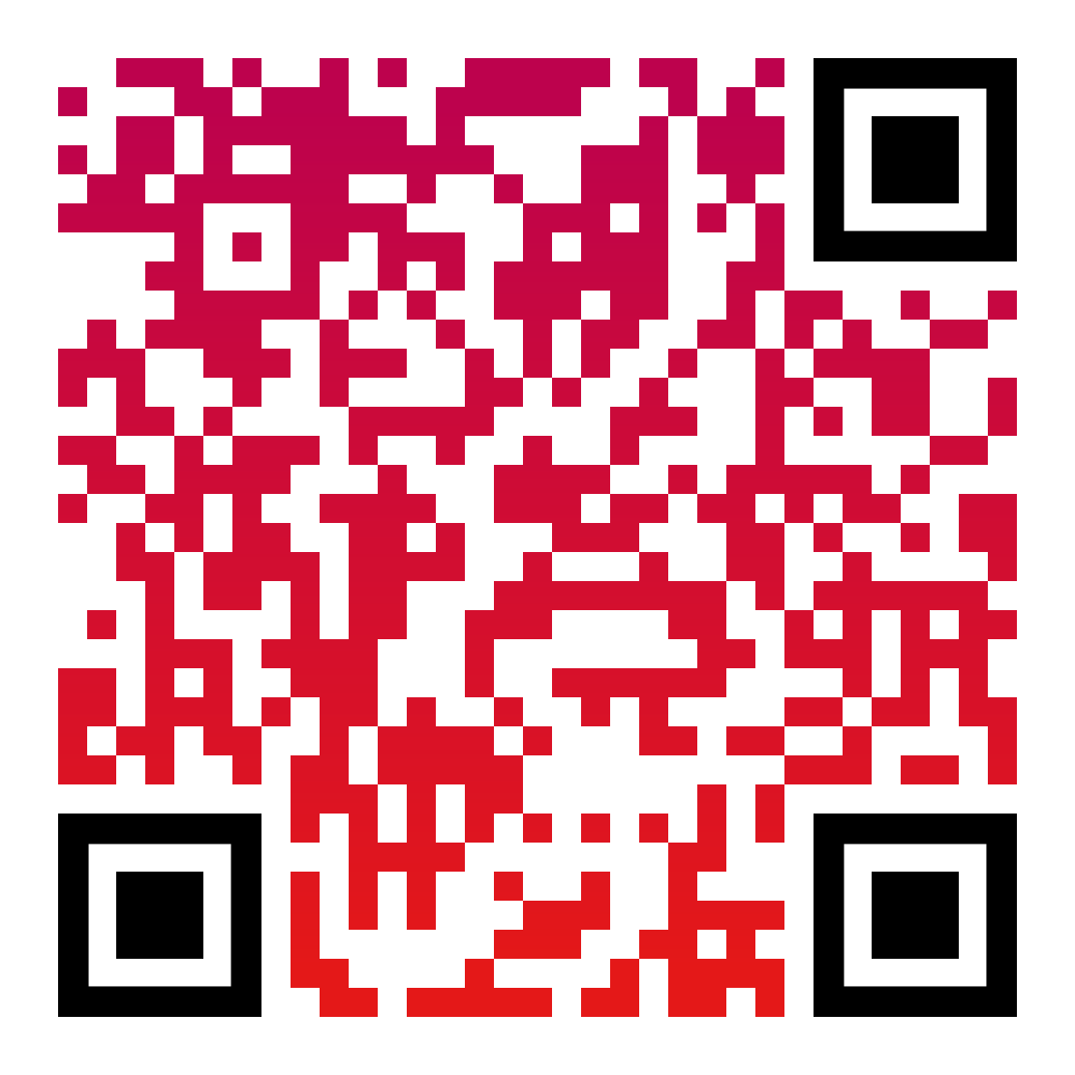
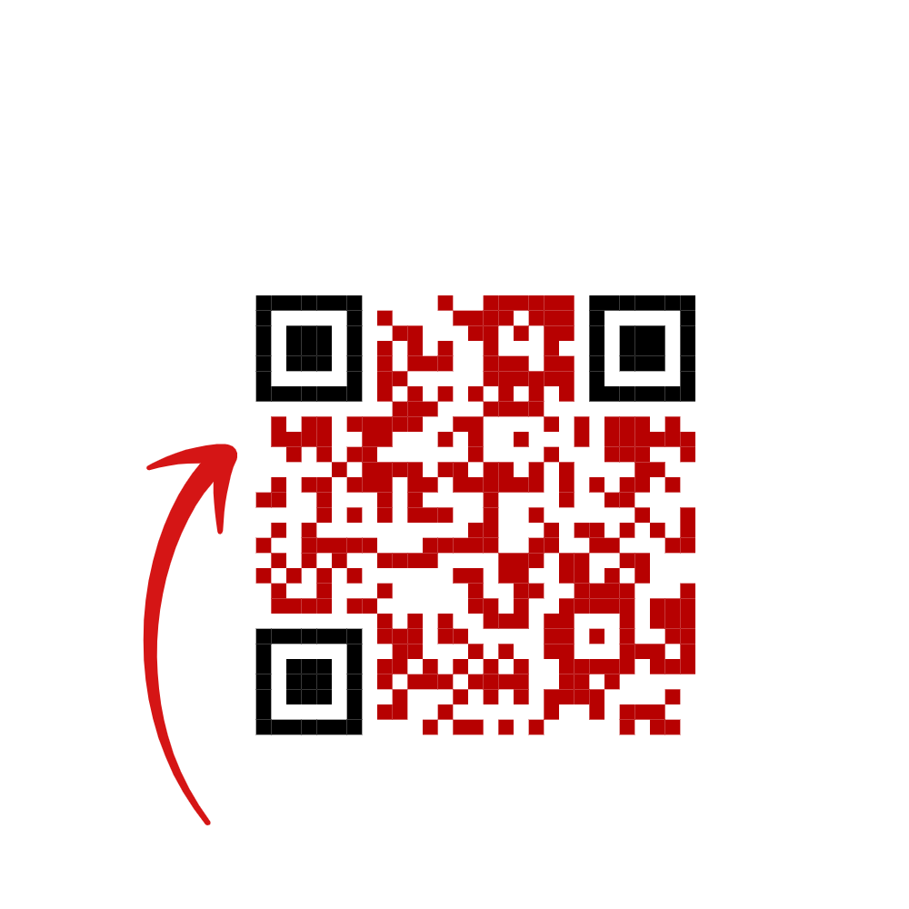


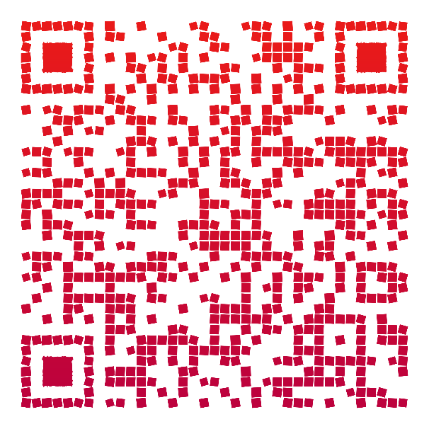
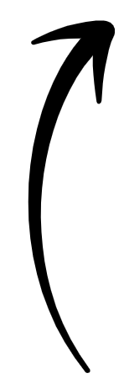
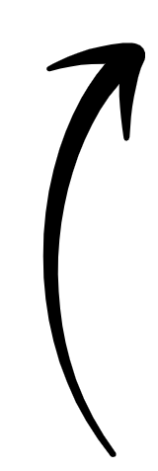
Annex: 30 Years on Giftedness in Vrsac (Book)
Explore International Opportunities at Our School
Institutional Department
for International Relations
26300 Vrsac
Omladinski trg 1
Tel.+381 13 831 628
Coordinator: Radmila Palinkasevic,PhD
Contact : +381 60 6188154
palinkasevic@gmail.com
About Us
Contact Us

